Slide 1
Alternative Dispute Resolution: Litigation, Arbitration, Mediation
Ola Stoklosa
October 2, 2025

Slide 2

Why?
To Court, or not to Court
Professional liability claim
Tendering dispute
Delay claim
Lien claim
Breach of contract
Employment

Slide 3
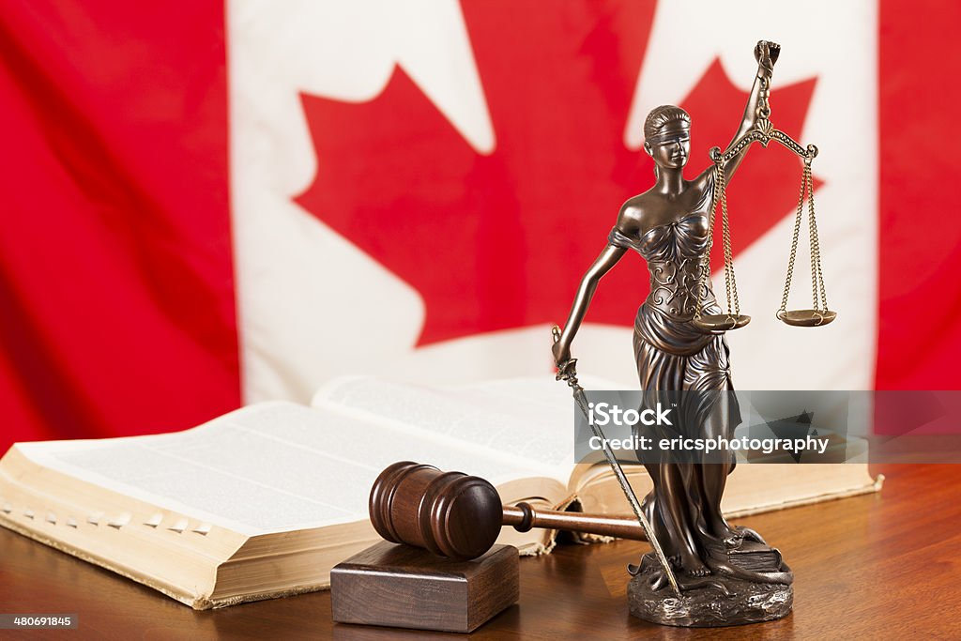
Litigation
To Court, or not to Court
Should you hire a lawyer?
Consider:
whether the other parties have lawyers
the complexity of the claim
the amount of the claim
applicable insurance
It is always prudent to have an initial consult with a lawyer to find out your rights and liabilities, and to help you navigate the beginning stages of the litigation process

Slide 4
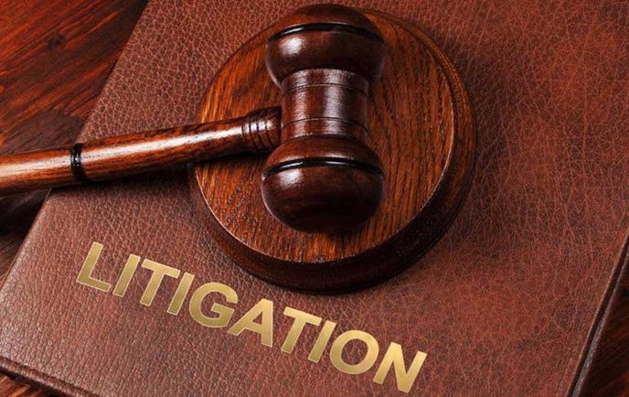
Litigation Basics
To Court, or not to Court
Parties
Pleadings
Process
Trial

Slide 5

Litigation Basics
To Court, or not to Court
Choose your Forum

Slide 6
SMALL CLAIMS
(<$35,000)
Advantages:
Inexpensive
Fast
mechanisms are in place to encourage the settlement of the claim in advance of trial
Disadvantages:
you may have to abandon part of your claim to fit within the <$35,000 jurisdiction
many remedies are not available such as actions for builders liens, specific performance
fewer processes in place for fact-finding

Slide 7
B.C. Supreme Court
(<$35,000)
Advantages:
very comprehensive discovery process
wider range of judicial discretion and remedies
Disadvantages:
very slow
can be very expensive

Slide 8

Civil Resolution Tribunal
The CRT is Canada’s first online tribunal. The CRT resolves:
small claims disputes up to $5,000
strata property (condominium) disputes of any amount
societies and cooperative associations disputes of any amount
shared accommodation and some housing disputes up to $5,000
The CRT helps people to resolve their disputes quickly and affordably, and encourages a collaborative approach to dispute resolution
CRT decisions are public and searchable

Slide 9
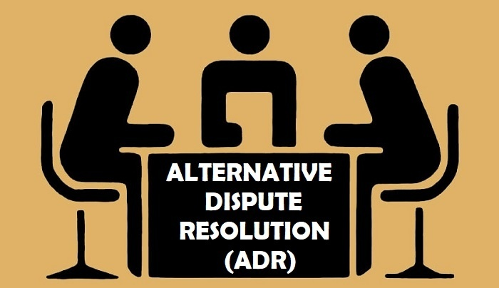
Alternative Dispute Resolution
As costs of litigation continue to climb, there is an increasing push towards methods of alternative dispute resolution

Slide 10
Arbitration
A method of dispute resolution involving one or more neutral third parties, usually agreed to by the disputing parties, whose decision is binding.
Like a mini-trial, you both lead evidence before an Impartial Arbitrator
Pros:
avoids litigation
Binding
hard to appeal
Confidential
efficient, flexible
Cons:
arbitrators can be expensive
you must adhere to their ruling
not mandatory (unless it is)

Slide 11

Mediation
A method of non-binding dispute resolution involving a neutral third party who tries to help the disputing parties reach a mutually agreeable solution. It is like sitting around a table and talking, airing grievances and trying to settle on a mutually agreed outcome.
Pros: inexpensive, therapeutic, early resolution, control over outcome, flexible relief
Cons: may not be taken seriously, need a genuine interest to resolve the issues from both parties.

Slide 12
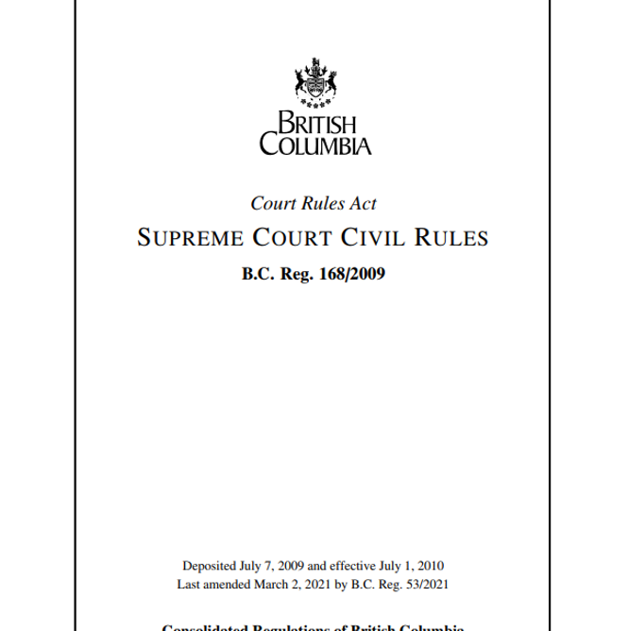
Expert Evidence
Rule 11-2 of the Supreme Court Civil Rules:
Duty of expert witness
(1) In giving an opinion to the court, an expert appointed under this Part by one or more parties or by the court has a duty to assist the court and is not to be an advocate for any party.

Slide 13

Expert evidence
Advice and certification
(2) If an expert is appointed under this Part by one or more parties or by the court, the expert must, in any report he or she prepares under this Part, certify that he or she
(a) is aware of the duty referred to in subrule (1),
(b) has made the report in conformity with that duty, and
(c) will, if called on to give oral or written testimony, give that testimony in conformity with that duty.

Slide 14

Who can be an expert?
Requires skill, expertise, training and experience
Pros:
sharing expertise
good for business
intellectually challenging
money/$$$
Cons:
work-intensive
stressful
scrutiny

Slide 15
Thank you. Any questions?
Ola Stoklosa
+1 604 408-2041

